Slide 1

#ISOLVE4ABILLION Prioritize vaccine delivery using AI/ML
EY Techathon 2021: #iSolve4aBillion Challenge
Aazaad Batra
Radhika Rajkumar

Slide 2
Team name and member details
1. Aazaad Batra
2. Radhika Raj Kumar
Problem statement: India’s biggest delivery challenge
Prioritize vaccine delivery using AI/ML

Slide 3
Problem statement – Our understanding
There’s a huge challenge before the country, that of vaccinating its over 1 billion strong population. The challenge requires planning and prioritization so COVID-19 is arrested at the earliest without a chance of returning.
If people at the maximum risk of contracting the virus are not vaccinated on time, India will continue to have casualties since it will take longer to contain the spread of this devastating virus.
Delivery of this mammoth task also requires proper planning to ensure minimum disruption and adequate transportation and supply, keeping in mind limitations such as storage capacity, and more.

Slide 4
Solution
How the solution will help solve the problem
Impact metrics to analyze the efficacy
Framework / Tools / Technology
The solution uses machine learning to accurately identify the segments of population that should be prioritized for vaccination.
Such prioritization will help ensure the most vulnerable and at risk of coming in contact with others are vaccinated first so the virus is contained at the earliest.
Sero survey results
Distribution across the country such that no state is lacking and no state has excess of the limited vaccine available for administration initially.
Machine learning
Language: Python
Key algorithm Random Forest
Method: Clustering and classification
Assumptions, constraints, decision points
Ease of implementation
Extent of scalability
Constraint: Data is available at the state level and some publicly available data is dated. ML requires comprehensive and large datasets such as test reports and CT values of infected patients and more.
The solution accurately identifies the population to be prioritized.
Next, identified population needs to be located and vaccinated. Approaches could include collaborating with organizations for vaccination drives.
For densely populated areas or slums vaccine must be administered at minimal cost.
The code can be modified easily to accommodate a larger dataset if made available.
Once the ML model is trained and tested, the solution can be used by various states, cities, towns, villages and talukas by using an API.
*The prototype doesn’t include all the steps mentioned here.

Slide 5


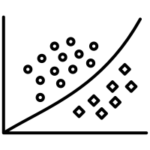
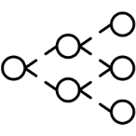




Methodology / Approach / Pipeline
*This is the complete pipeline. The prototype doesn’t include all the steps mentioned here.
Expose the model by writing an API
Input data
Data cleaning
Preparing dataset for ML training
State-level data for percentage population suffering from illnesses such as diabetes, heart condition, respiratory problems, high blood pressure, and more.
State-level data for characteristics of population such as availability of clean fuel for cooking, availability of sanitization facilities, and more.
State-level data about incidence and casualty due to Covid.
Deleting duplicate records
Handling missing values
Creating columns / rows in the dataframe as required for analysis
Splitting the dataset into training and test dataset (80%-20%)
Assigning weightage to certain parameters if required
Front-end for consuming the API
Input variables
Feature Selection and Engineering
Training the ML model
Retaining only relevant variables / features
Analyzing the data type: numeric, float, categorical
Handling categorical data
Analyzing distributions
Handling outliers
Running groups of data as mini test-sets
User terminal

Slide 6

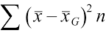








System / Block Diagram for the prototype
Data visualization
Visualization
Random Forest for feature selection
Classification
Clustering to determine state clusters as per Covid data
Clustering
Treatment for missing values
Removal of data duplication
Data cleaning with Python
Data collection

Slide 7
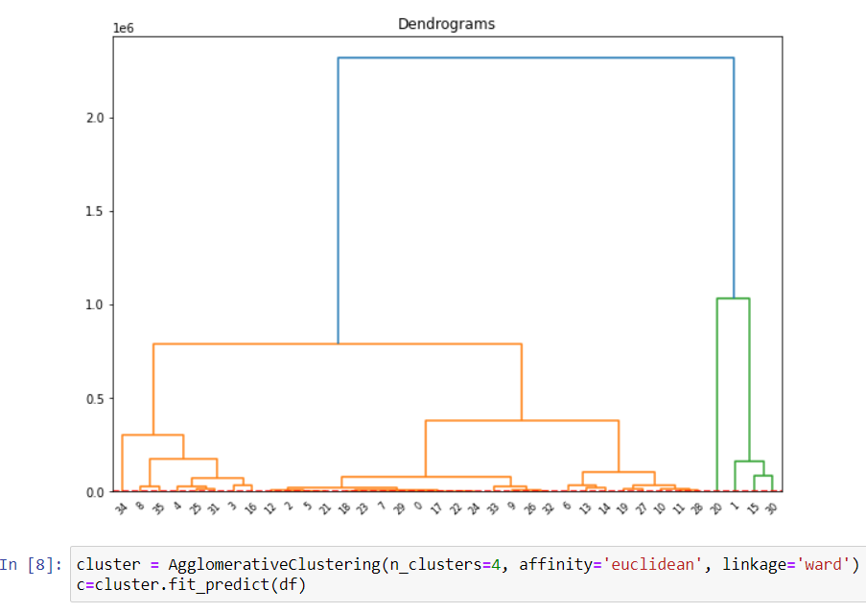
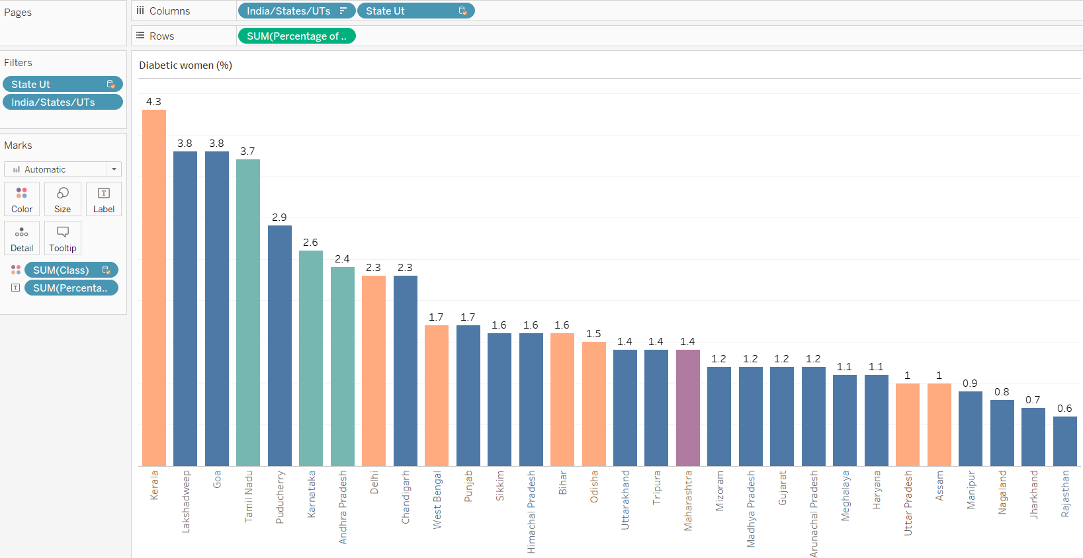
Snippets of code and a glimpse of visualization
Dendrogram for clustering
Tableau visualization for % of diabetic women by state

Slide 8
Working prototype
Link to code execution: https://youtu.be/mC47Z8IDuVM
Github repository: https://github.com/aazaadbatra/Covid

Slide 9
Thank You.
aazaad_batra_ampba2021s@isb.edu
radhikasivagangai_rajkumar_ampba2021s@isb.edu

